Slide 1
Asynchronous programming. Multiprocessing

Slide 2
What is concurrency?
Simultaneous execution
Potentially interacting tasks
Uses multi-core hardware
Includes Parallelism.

Slide 3

What is a process?
An independent process-of-control.
Processes are “share nothing”.
Must use some form of Inter-Process Communication to communicate/coordinate.
Processes are “big”.

Slide 4
Uses for Processes?
When you don’t need to share lots of state and want a large amount of throughput.
Shared-Nothing-or-Little is “safer” then shared-everything.
Processes automatically run on multiple cores.
Easier to turn into a distributed application

Slide 5
The difference?
Threads are implicitly “share everything” - this makes the programmer have to protect (lock) anything which will be shared between threads.
Processes are “share nothing” - programmers must explicitly share any data/state - this means that the programmer is forced to think about what is being shared
Explicit is better than Implicit
Notes:
Python does not use “green threads”. It has real threads. OS Ones. Stop saying it doesn’t.

Slide 6

The GIL?
GIL: “Global Interpreter Lock” - this is a lock which must be acquired for a thread to enter the interpreter’s space.
Only one thread may be executing within the Python interpreter at once.

Slide 7
What is multiprocessing?
Follows the threading API closely but uses Processes and inter-process communication under the hood
Also offers distributed-computing faculties as well.
Allows the side-stepping of the GIL for CPU bound applications.
Allows for data/memory sharing.
CPython only

Slide 8
What is multiprocessing?
Exactly like threading:
Thread(target=func, args=(args,)).start()
Process(target=func, args=(args,)).start()
You can subclass multiprocessing.Process exactly as you would with threading.Thread.

Slide 9
What is multiprocessing?
from threading import Thread
threads = [Thread(target=do_work, args=(q,)) for i in range(8)]
from multiprocessing import Process
processes = [Process(target=do_work, args=(q,)) for i in range(8)].

Slide 10
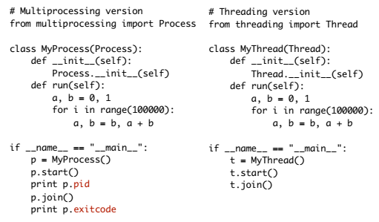
What is multiprocessing?

Slide 11
Queues
multiprocessing includes 2 Queue implementations – Queue and JoinableQueue.
Queue is modeled after Queue.Queue but uses pipes underneath to transmit the data.
JoinableQueue is the same as Queue except it adds a .join() method and .task_done() ala Queue. Use queue module in python 3.6.

Slide 12
Queue.warning
The first is that if you call .terminate or kill a process which is currently accessing a queue: that queue may become corrupted.
The second is that any Queue that a Process has put data on must be drained prior to joining the processes which have put data there: otherwise, you’ll get a deadlock.
Avoid this by calling Queue.cancel_join_thread() in the child process.
Or just eat everything on the results pipe before calling join (e.g. work_queue, results_queue)

Slide 13
Pipes and Locks
Multiprocessing supports communication primitives.
multiprocessing.Pipe(), which returns a pair of Connection objects which represent the ends of the pipe.
The data sent on the connection must be pickle-able.
Multiprocessing has clones of all of the threading modules lock/RLock, Event, Condition and semaphore objects.
Most of these support timeout arguments, too!

Slide 14
Shared Memory
Multiprocessing has a sharedctypes module.
This module allows you to create a ctypes object in shared memory and share it with other processes.
The sharedctypes module offers some safety through the use allocation of locks which prevent simultaneous accessing modification of the shared objects.
from multiprocessing import Process
from multiprocessing.sharedctypes import Value
from ctypes import c_int
def modify(x):
x.value += 1
x = Value(ctypes.c_int, 7)
p = Process(target=modify, args=(x))
p.start()
p.join()
print(x.value)

Slide 15
Shared Memory
Multiprocessing has the Pool object. This supports the up-front creation of a number of processes and a number of methods of passing work to the workers.
Pool.apply() - this is a clone of builtin apply() function.
Pool.apply_async() - which can call a callback for you when the result is available.
Pool.map() - again, a parallel clone of the built in function.
Pool.map_async() method, which can also get a callback to ring up when the results are done.
Fact: Functional programming people love this!

